Slide 1

Process library structure

Slide 2

What is process library?
Simply put, a process library is a document management system that enables businesses to store information about their processes in the cloud, helping to keep them both organized and accessible.

Slide 3
Why are process libraries important?
Having a solid process management system is key for any modern, forward-focused business and will help glue your business together. As we progress further into the digital age, relying on old physical methods of management will only slow you down and push you behind the companies that are utilizing digital methods of storing and collecting data.
Creating a process library is a key aspect of business process management and will ensure you’re reaching your full potential. Below, we take an even deeper dive into the importance of process libraries, and how they could benefit your organization.

Slide 4
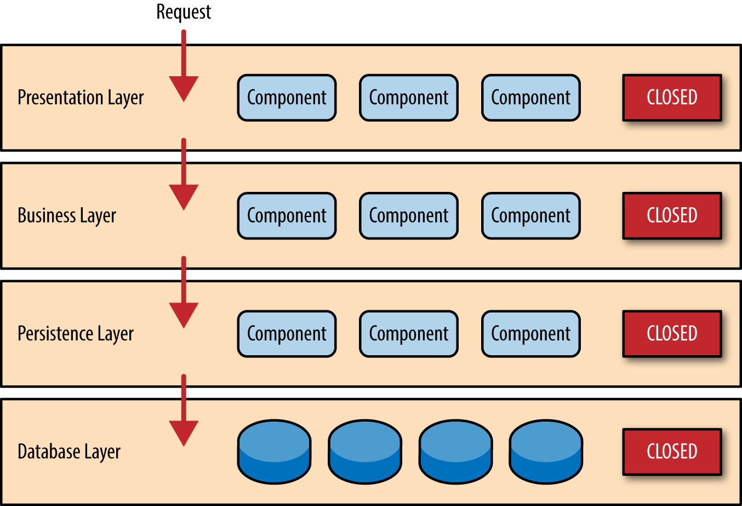
Diagram of process library layers or levels
The customer enters the layers through the presentation layer which is displayed first on the screen. After which customer completes the process in the business which then interacts with the persistence layer and the data is stored in the database layer which is neither accessible nor visible to the customer.

Slide 5
Examples of process library structure Customer Journey Structure
Customer acquisition
Lead generation
Onboarding
Retention
Customer support
Upselling/Cross-selling
Churn prevention
Customer feedback
Win-back strategies

Slide 6
Examples in IT industry Incident Management
Identification
Categorization
Logging
Prioritization
Resolution
Closure

Slide 7
Examples in IT industry Change management
Request for Change Management
Review and Approval
Implementation
Verification and Testing
Documentation
Post change evaluation

Slide 8
How to create a process library?
Creating a process library structure involves careful planning and consideration of your organization's specific needs and workflows. Here is a step-by-step guide to help you create an effective process library structure:
1. Define purpose and scope: Determine why you need a process library and what processes it will encompass. Consider the goals, objectives, and intended outcomes.
2. Identify Key Stakeholders: Involve relevant stakeholders from different departments or teams. Their input will be crucial in shaping the structure.
3. Analyze and categorize processes: Review the processes and categorize them based on common themes, functions, or departments. This will help in grouping related processes together.

Slide 9
How to create a process library?
4. Selecting a structuring method: Choose a suitable structuring method based on the nature of your organization and the processes involved. For example, functional department-based, chronological, or project- based.
5. Create main categories and sub-categories: Establish main categories that represent high-level process groupings. Then, further break down these categories into subcategories.
6. Plan for version control: Decide how versioning of documents will be handled. Establish a system for tracking changes and ensuring users access the latest versions.
7. Set access permission and security Define who will have access to the process library and at what permission levels. Implement security measures to protect sensitive information.

Slide 10
How to create a process library?
8. Create templates and guidelines: Develop standardized templates for documenting processes. Include guidelines for consistency and completeness in documentation.
9. Document processes: Start populating the process library with detailed documentation for each process. Include step-by-step instructions, diagrams, and any relevant attachments.
10. Provide support and resources: Offer ongoing support and resources for users to navigate and utilize the process library effectively.
11. Monitor Usage and Effectiveness Track metrics related to the usage and effectiveness of the process library. Use this data to make adjustments as necessary.

